Slide 1
Ministries, AHPs and Short Term Plans: What Is a State to Do?
Tuesday, May 29, 2018
3:00pm-4:00pm Eastern
Supported by The Robert Wood Johnson Foundation

Slide 2
Today’s Experts
Kevin Lucia, Senior Research Professor, Center on Health Insurance Reforms, Georgetown University
Kevin Lucia, J.D., M.H.P., is a Research Professor and Project Director at Georgetown University's Health Policy Institute. As part of a specialized research team, Mr. Lucia conducts extensive legal analysis on how states and the federal government regulate private health insurance with a focus on access, affordability and adequacy of coverage. Mr. Lucia's research includes analysis of state and federal laws, pending legislation, and current market practices related to private health insurance.
Dania Palanker, Assistant Research Professor, Center on Health Insurance Reforms, Georgetown University
Dania Palanker, J.D., M.P.P. is an Assistant Research Professor at the Center on Health Insurance Reforms (CHIR) at Georgetown’s Health Policy Institute. She analyzes state and federal health insurance market reforms, including implementation of the Affordable Care Act (ACA), with an emphasis on insurance benefit design, access to health care, and coverage for chronic health conditions.
JoAnn Volk, Senior Research Professor, Center on Health Insurance Reforms, Georgetown University
JoAnn Volk, M.A. is a Research Professor at the Georgetown University Center on Health Insurance Reforms. There she directs research, authors papers, and provides technical assistance on state and federal regulation and legislation governing private health insurance, including health insurance marketplaces under the Affordable Care Act.

Slide 3
Ministries, AHPs and
Short Term Plans:
What Is a State to Do?
Kevin Lucia, J.D., M.H.P.
Dania Palanker, J.D., M.P.P.
JoAnn Volk, M.A.
Georgetown University
Center on Health Insurance Reforms
May 29, 2018

Slide 4
About Georgetown’s Center on Health Insurance Reforms (CHIR)
A team of experts on private health insurance and health reform
Conduct research and policy analysis, provide technical assistance to federal and state policymakers, regulators, and consumer advocates
Based at Georgetown University’s McCourt School of Public Policy
Learn more at https://chir.georgetown.edu/.

Slide 5
Alternative Coverage Options
Threatening the Stability of the Individual Market
Effort to expand the availability of and access to alternatives to ACA-compliant insurance
  Presidential Executive Order issued October, 2017
Risk of healthy enrollees could be siphoned out of the individual market
Leading to smaller, sicker risk pool with consumers facing higher premiums and fewer plan options
Problem could be compounded when individual mandate is eliminated in 2019

Slide 6
Alternative Coverage Options
Threatening the Stability of the Individual Market
Alternative Coverage Options Poised to Expand in 2019
  Short Term Plans
    Final regulation in development
  Association Health Plans
    Final regulation at OMB
  Health Sharing Ministries
    Current exemption from individual mandate
  Others

Slide 7
Short-Term Limited Duration Insurance: Background
Designed to fill temporary gaps in coverage
  Pre-ACA provided HIPAA creditable coverage
Not considered individual health insurance under federal law.
  Separate risk pool from ACA-compliant market.
Exempt from ACA standards.
  Unless state provides otherwise.

Slide 8
Short Term Plans: Exclusions
Almost always exclude pre-existing conditions
Often exclude some Essential Health Benefits*
  100% exclude maternity
  71% exclude prescription drugs
  62% exclude substance use treatment
  43% exclude mental health
  *Source: Kaiser Family Foundation
Other exclusions in plans currently for sale:
  Treatment of joints, spine, bones, connective tissue unless an injury
  Hospital emergency due to illness (unless confined)
  Kidney or end stage renal disease

Slide 9
Short-Term Plans: Limits and Cost-Sharing
Benefits generally capped $250,000 - $2 million
  Some per contract period, others per lifetime
Some issuers use internal limits such as:
  $2,500 in surgeon & anesthesiologist fees per surgery
  $1,000 per night in hospital
  $250 for ambulance
  $150,000 for transplant services
Different Cost-Sharing Conventions
  Deductible may not count towards out of pocket maximum
  Family deductible may be 3x the individual deductible

Slide 10
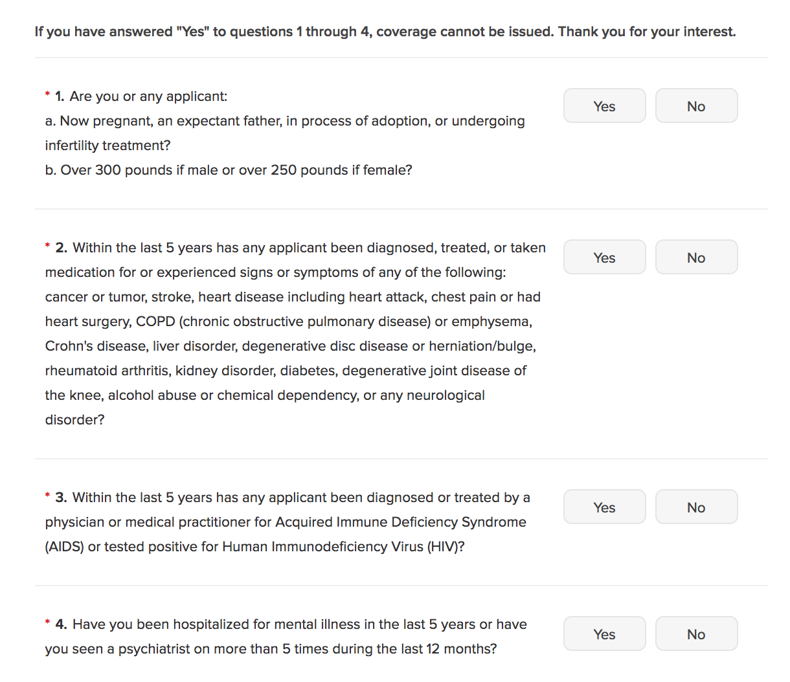
Short Term Plans: Underwriting
Post-claims underwriting can lead to rescission even if initially pass underwriting
Source: eHealthinsurance.org

Slide 11
Short-term Plans: Federal Regulation
Rule change in 2016, because of concerns:
  Consumers were using short-term as primary coverage (not as a gap-filler)
  Short-term enrollment causing adverse selection against compliant market
Current rule: Coverage duration must be less than 3 months, including extensions
  Enrollment in STLDI does NOT satisfy individual mandate
Proposed rule change in 2018
  Extend duration allowance to less than 12 months
  Allow extensions (with issuer’s consent) beyond this term
  [And, no mandate penalty in 2019.]

Slide 12
Short-term Plans: Current State Regulation
Some states limit contract duration:
  6 or 12 months most common limits
  OR and VT limit to 3 months
  Some states exempt plans under 6 months from some regulations, but allow longer plans
Ten states require coverage of all state benefit mandates
  Such as diabetes care management or TMJ treatment
  No states require coverage of all Essential Health Benefits
Three states effectively ban short-term plans
  MA, NJ, NY

Slide 13
State Options to Address Short-Term Plans (1)
Limit contract duration to 3 or 6 months
Prevent stacking of multiple plans
  Prohibit renewals & define renewals as issuance of new policy within specified timeframe
  Limit coverage by one insurer to specified timeframe in 365 day period
  Limit coverage of individual in short-term plans to specified timeframe in 365 day period
Prohibit waiving health status underwriting to people already enrolled

Slide 14
State Options to Address Short-Term Plans (2)
Level playing field by requiring compliance with (some/all) individual market rules
  All state benefit mandates
  Essential health benefits
  No rescissions
  Preexisting condition protections
  Appeals process
Reduce risk of market segmentation
  Assess short-term issuers for reinsurance funds
  Set minimum medical loss ratio (MLR)
  Limit rating factors
  Prohibit sale to people eligible for marketplace coverage

Slide 15
State Options to Address Short-Term Plans (3)
Improve transparency and oversight
  Track enrollment
  Conduct regulatory review
  Require additional consumer disclosures
Other state efforts underway:
  Ban short-term plans
  Use regulatory authority to define, limit duration, improve consumer protections

Slide 16
Questions on Short Term Plans
Dania Palanker, J.D., M.P.P.
Assistant Research Professor
Georgetown University
Center on Health Insurance Reforms
Dania.palanker@georgetown.edu
202-687-0964

Slide 17
Association Health Plans:
Background and Current Framework
AHP → health plan sponsored by an employer-based association, such as a professional or trade group
AHPs exist under the ACA but are not a distinct category of health insurance coverage.
  AHP coverage sold to:
    Individuals is regulated as individual market coverage;
    Small groups is regulated as small group market coverage
Exception: when a group of employers can be considered bound together as a bona fide single employer group → may be treated as a large-employer health plan

Slide 18
Association Health Plans:
Proposed Rule
Would make it easier for employers to join together to form associations that would be treated as large-group coverage
  AHP could form solely for purpose of offering insurance
  Commonality of interest could be demonstrated where members are:
    In the same trade/industry, etc., or
    Have their principal place of business in the same geographic region (including multistate metro areas)
Would allow membership by the self-employed

Slide 19
Association Health Plans:
Proposed Rule
Would prevent AHPs from conditioning membership on health status, or using health status in determining benefit eligibility and premiums
As a large-group plan, an AHP would NOT be subject to ACA rules regarding premium rating and benefits
Raises possibility of preemption of state regulatory authority

Slide 20
Association Health Plans:
The Intent of Rule Change
Responding to executive order directing agencies to consider regulations expanding access to AHPs
Make it easier for small employers and the self-employed to achieve advantages of scale sometimes enjoyed by large employers
  Reducing admin costs
  Facilitating self-insurance
  Greater market power
Gives consumers more options at lower premiums

Slide 21
Association Health Plans: The Risks
AHPs have a long history of financial instability, insolvencies, and fraud
  States generally have a better track record than the feds in limiting these problems
Tradeoffs that come with increased plan flexibility
  Proposal allows AHPs to vary rates by age (without limitation), gender, occupation, and group size
  Benefit packages can be designed to discourage enrollment by those likely to use care
Plans playing by different rules → segmentation and adverse selection
  Siphons off healthy risks, leaving compliant market smaller, sicker, and more expensive
  This was pre-ACA experience (e.g., Kentucky)

Slide 22
State Options to Address AHPs
Level the playing field
  Require compliance with (some/all) individual/small group market rules
Restrict AHPs
  CA does not allow new MEWAs, so only a handful remain
Limit membership to small businesses
  Employers with at least 1 employee
Reduce risk of market segmentation
  Assess AHPs; invest funds in reinsurance
Assert jurisdiction over out-of-state AHPs

Slide 23
Questions on Association Health Plans
Kevin Lucia, J.D., M.H.P.
Research Professor
Georgetown University
Center on Health Insurance Reforms
kwl@georgetown.edu
202-687-4928

Slide 24
Health Care Sharing Ministries: Background
Historically, an alternative for certain religious communities that object to traditional insurance, instead share members’ health care cost burdens
How they work:
  Membership limited to those who share religious beliefs (although not in all cases)
  Members make defined monthly contribution (“share”)
    May vary based on level of coverage, age, health indicators
  Members submit claims for “sharing” and if eligible, can have costs offset by other members’ shares; claims typically deemed ineligible include those that are:
    Considered in conflict with religious test for members
    Related to a pre-existing condition

Slide 25
Health Care Sharing Ministries: Regulation
ACA recognized their role for certain religious communities by granting exemption from the individual mandate
  ACA exemption applies to defined ministries at 26 USC 5000A(d)(2)(B)
  Does not impede state authority to regulate HCSMs
30 states have safe harbor for HCSMs, specifically exempting them from insurance regulation
  Typical features: requirement to provide monthly statement of member payment requests and contributions and written notice that HCSM is not insurance nor a guarantee of payment. Some required annual audit be publicly available

Slide 26
Health Care Sharing Ministries:
Membership and Features
Enrollment in HCSMs has reportedly grown substantially, from fewer than 200,000 before ACA to more than a million
  No independent data on membership
  Audits required under ACA and some state safe harbors provide only financial information
ACA mandate exemption may have been original driver, but affordability appears to be primary driver now
Many using features that closely resemble insurance:
  Advertising during open enrollment
  Paid brokers
  Provide network
  Pre-existing condition exclusions

Slide 27
Health Care Sharing Ministries:
Potential Risks
Consumer confusion: marketing and plan designs may mislead consumers into thinking they’re getting insurance
Some features may cross line into something more akin to operating as an insurer
Depending on actual membership and future growth, could contribute to selection against regulated market
Most enroll individuals and families, but at least one markets to small employers

Slide 28
State Options to Address HCSMs
Establish reporting requirement to collect data to understand growth and potential impact on market
Issue consumer alert educating consumers on limits of HCSMs
In states with safe harbor, monitor for compliance with definition of exempt HCSMs
  Some features, in particular, might fall outside definition, such as use of brokers, facilitating payments between members, failure to apply religious test for membership
Take action against those that operate illegally as insurers

Slide 29
Questions on Health Care Sharing Ministries
JoAnn Volk, M.A.
Research Professor
Georgetown University
Center on Health Insurance Reforms
joann.volk@georgetown.edu
202-687-3944

Slide 30
Thank You!
Kevin Lucia
kwl@georgetown.edu
202-687-4928
Dania Palanker
dania.palanker@georgetown.edu
202-687-0964
JoAnn Volk
joann.volk@georgetown.edu
202-687-3944

Slide 31

Questions & Discussion
Please type your questions into the chat box.

Slide 32
Thank you!
Your opinion is important to us. After the webinar ends, you will be redirected to a web page containing a short survey. Your answers to the survey will help us as we plan future NASHP webinars.

