Slide 1
EvidenceNOW: Insights for State Health Policymakers on Advancing Evidence-based Primary Care
Thursday, April 12, 2018 3:00pm-4:00pm Eastern
Supported by the Heart of Virginia Healthcare

Slide 2
Agenda
3:00pm ET | Welcome and Introductions Jennifer Reck, Project Director, NASHP
3:05pm ET | Panel Discussion Moderator: Daniel Carey, MD, Secretary of Health and Human Resources, Commonwealth of Virginia Speakers: Kurtis Elward, MD, MPH, FAAFP, Heart of Virginia Healthcare Steven Crawford, MD, FAAFP, DABFM, Healthy Hearts for Oklahoma Ann Lefebvre, MSW, CPHQ, Heart Health Now! Advancing Heart Health in NC Primary Care
3:50pm ET | Audience Q&A

Slide 3

EvidenceNOW
AHRQ grant initiative launched May 2015
Seven cooperatives spanning 12 states reaching 1,500 small- to mid-sized primary care practices:
Northwest (WA, OR, ID), Midwest (WI, IL, IN), Southwest (CO, NM), New York City, Oklahoma, North Carolina, Virginia
Goal: Use evidence to improve the ABCs of heart health
Aspirin use by high-risk individuals
Blood pressure control
Cholesterol management
Smoking cessation

Slide 4
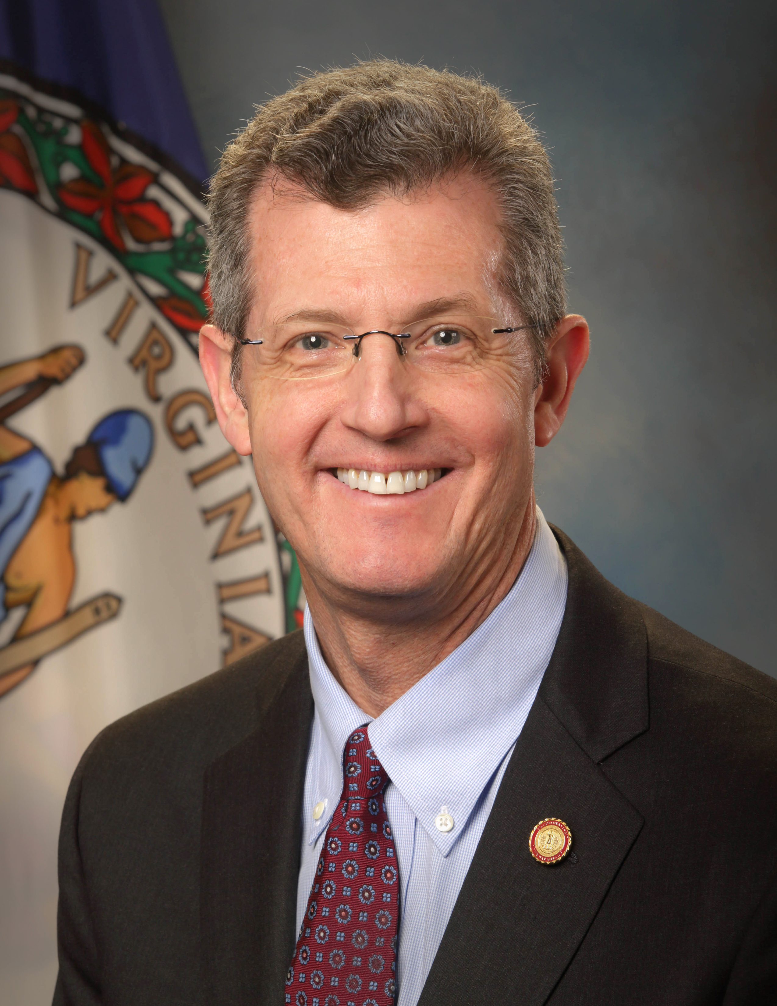
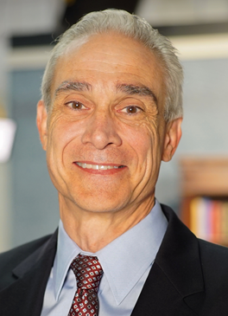

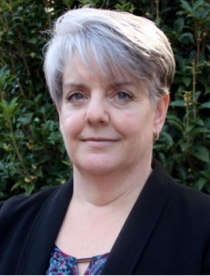
Today’s Panel
Moderator | Speakers
Daniel Carey, MD, Secretary of Health and Human Resources, Commonwealth of Virginia | Kurtis Elward, MD, MPH, FAAFP, Heart of Virginia Healthcare | Steven Crawford, MD, FAAFP, DABFM, Healthy Hearts for Oklahoma | Ann Lefebvre, MSW, CPHQ, Heart Health Now! Advancing Heart Health in NC Primary Care

Slide 5
What was your cooperative’s approach to advancing evidence-based prevention?

Slide 6

What challenges or barriers did you face in your work?

Slide 7
What are the key takeaways you learned that could help states better understand effective models, tools, interventions, and/or policy levers for advancing evidence-based prevention?

Slide 8
Where do you see (or where would you like to see) your state going in the future based on your experiences in EvidenceNOW?

Slide 9

Questions & Discussion
Please type your questions into the chat box.
9

Slide 10
Thank you!
For additional information, please see NASHP’s recent brief Lessons in Advancing Evidence-based Primary Care from the Heart of Virginia Healthcare EvidenceNOW Cooperative.
Your opinion is important to us. After the webinar ends, you will be redirected to a web page containing a short survey. Your answers to the survey will help us as we plan future NASHP webinars.

