Slide 1
Using Evidence to Achieve Effective State Health Policy
Wednesday, March 29, 2017 3:00pm-4:00pm Eastern
Supported by a Patient-Centered Outcomes Research Institute (PCORI) Program Award

Slide 2
Webinar Agenda
3:00pm ET | Welcome and Overview Greg Martin, PCORI
3:05pm ET | Panel Discussion Moderator: Greg Martin, PCORI Panelists: Gary Franklin, Washington Kimberley Smith, Colorado
3:35pm ET | Engaging Consumers in Evidence-Based Policymaking Rob Walker, Massachusetts Margaret Guyer, Massachusetts
3:45pm ET | Audience Q&A

Slide 3



Panel Discussion
Greg Martin Deputy, Chief Engagement and Dissemination Officer PCORI (Moderator) | Gary Franklin Medical Director, Washington State Department of Labor and Industries Co-Director, Washington Agency Medical Directors’ Group | Kimberley Smith Compliance & Stakeholder Relations Unit Manager, Colorado Department of Health Care Policy & Financing

Slide 4
1. What programs does your state have in place to apply evidence to state health policy?

Slide 5
Evidence-Based Medicine (EBM)
Health Affairs: “EBM is a set of principles and methods intended to ensure that to the greatest extent possible, medical decisions, guidelines, and other types of policies are based on and consistent with good evidence of effectiveness and benefit.”
Eliminates variations in provision of care
Stops providers from using treatments that are out of date, useless, or harmful
Helps eliminate medical errors

Slide 6
Federal Oversight | Drugs | Medical Devices | Medical Procedures
Required for FDA approval | 2 prospective, placebo controlled RCTs | “Substantial equivalence” to preexisting device | No approval requirements
Study outcomes | Disease-related endpoints | Engineering performance only | None
Published studies with patient-oriented endpoints? | Common | Uncommon | Not Considered
Patient population | Narrowly defined set of conditions (e.g., depression, dementia) | Varies widely (e.g., implantable defibrillators, laparoscopes) | Not Considered
Post-marketing evaluation? | Sporadic, sometimes high quality | Rare, usually low quality | None

Slide 7
Washington State Authority for Evidence-Based Health Care Decisions
2003-SSB 6088-Established the Prescription Drug Program for all agencies-uses evidence within drug classes to determine coverage-translates to formulary
2003-SHB 1299-all agencies to conduct formal assessment of scientific evidence to inform coverage, track outcomes-Agency Medical Director’s Group
2005-Budget proviso-Agencies to collaborate on coverage and criteria (guidelines)
2006-Gov request legislation-HB2575/SB6306 to establish 1st State Health Technology Assessment Program-mandatory for public agencies
2011-HB 1311-establishes Bree (public/private) collaborative on implementing guidelines

Slide 8
What is The Benefits Collaborative Process?
The process: A policy development process that engages stakeholders:
At each stage of policy design; and
In a structured way (e.g. within a defined scope and defined constraints)
The product: A Benefit Policy that defines the amount, scope and duration of medical coverage for a particular benefit or set of services, i.e.:
What medical services are covered by Colorado Medicaid; and
Under what conditions
The purpose: To ensure that coverage policy is:
Based on the best available clinical evidence and best practices;
Is cost effective and sets reasonable limits upon those services; and
Promotes health and functioning of Medicaid clients.
Stakeholders are consultants: Throughout the process, stakeholders provide suggestions for policy improvement based on:
Evidence-based research and data
Peer reviewed literature
Personal and professional knowledge of the population served
Keys To Success: Clear guiding principles, transparency, and routine communication.
Notes:
Script:
So, let’s talk about this model…..
When stakeholders are engaged effectively in the policy decisions that impact them, the product almost always improves.
- Many of us are familiar with patient centered design principles – the idea that systems of care work better when they are designed and implemented with clients and families, not for them.
We think we have developed a model for public policy design that works in Colorado.
We call it the Benefits Collaborative Process.
[Read slide and add commentary below as you go]
Process – the process is policy-development process that includes a series of one to three public meetings, followed by consultation with our medical and children’s advisory councils and a public notice period. [Read item #1 on slide]. The word “structured” here is very important. In our first public meeting we define both the scope of the topic under discussion and the clearly explain the constraints our Department is operating under early and often. I am going to come back to these topics of defining scope and constraints later.
Product – [Read item 2]. For example, we may propose an Imaging policy in the first stakeholder meeting that lists the various types of radiology services we cover and under what circumstances, and then ask for comment.
Purpose – These three bullets are our Guiding Principles. We tell stakeholders early and often in the process that changes to policy drafts will only be operationalized if they are based on a body of evidence and best practice, are cost effective and promote health.
- IMPORTANT: Establishing criteria that will be used to make policy decisions is key to the success of any public policy design effort.
We use a consultancy model. Our stakeholders are our consultants. And we are very up-front about this at the start of each process.
- We tell stakeholders that they will not be voting; this is not a consensus model. Their role is to inform us of information we may not know - or have fully considered - and our role is to fully research that information.
- We tell stakeholders that we will review all information provided and read all case studies or journal articles submitted. We tell them we will look into specific client cases and we listen to their own experiences.
- But we are clear that feedback must be specific and verifiable. This limits the amount of anecdotal storytelling – which can be informative but is often difficult to research.
- We find that, sharing with stakeholders these guiding principles and being clear about the type of feedback we need, focuses their feedback and dramatically cuts down on feedback that doesn’t have a basis in demonstrable fact. And we find that stakeholders appreciate this guidance and really step up to the plate.
5. So, providing clear explanation (of the process, it’s purpose, roles and guiding principles) is one key to the success of this model, but transparency and routine communication are the other key ingredients.

Slide 9

Notes:
Will focus mostly on describing the Results first initiative.

Slide 10
Sister Agency Efforts to Apply Evidence to Policymaking
Colorado Department of Public Health and the Environment
Office of Behavioral Health
Notes:
Will talk about CDPHE and OBH.

Slide 11
2. How can state agencies work together on evidence-based policymaking?

Slide 12
Collaboration across executive health agencies is critical and expected
WA AMDG reports to sub-cabinet-Gov’s health policy advisor always involved
WA AMDG opioid guidelines 2007,2010,2015 could only have occurred via cross agency and public/private collaboration

Slide 13
Essential Elements From Washington State to Reduce Prescription Opioid Morbidity and Mortality
Franklin et al, A comprehensive approach to address the prescription opioid epidemic in Washington State: Milestones and lessons learned. Am J Publ Health Jan 20, 2015. e1–e7. doi: 10.2105/AJPH.2014.302367
Facilitate collaboration among state agencies.
Create strong pain management laws.
Establish dosing and best-practice guidelines and rules related to opioid use for acute, subacute, and chronic non-cancer pain.
Implement effective prescription drug monitoring programs and leverage health information technology to inform real-time decision-making.
Institute robust surveillance to track prescribing and use practices and health outcomes.
Incentivize use of best practices.
Initiate overdose education programs to mitigate risk to those already using opioids.
Increase access to medication-assisted treatment.
Evaluate impact of interventions.

Slide 14




Working with Our State Agency Partners
Notes:
As a precondition to participating in the learning collaborative opportunity sponsored through the National Academy of State Health Policy (NASHP), entitled From Engagement to Evidence: Using PCOR and CER to Inform State Policymaking, Colorado agreed to convene a team made up of various agency partners and patient partners, to pursue several key objectives. These included:
1. Increasing the use of evidence, including Patient Centered Outcomes Research (PCOR) and Comparative Effectiveness Research (CER), within state health policy decision making;
2. Establishing a structure (i.e. process or committee) for inter-agency collaboration on the use of this research;
3. Developing a strategy for the meaningful engagement of the patient in program & policy development;
4. Creating opportunity for each agency to share best research and patient engagement practices; and
5. Building capacity for internal staff and the general public to find and evaluate evidence.

Slide 15
CREATING A STRUCTURE FOR CROSS-AGENCY COLLABORATION
Project Goal: To design a cross-agency structure (i.e. process or
committee) that is inclusive of, and
transparent to, the public, and which empowers us to:
Share research best practices;
Share and review evidence of common interest;
Direct and guide staff across agencies in this work; and
Share findings/recommendations with existing policy-making bodies
at our agencies, for consideration when making policy decisions
Notes:
Specifically, we are attempting to design: Design an inter-agency collaborative structure, including:
• a mechanism to identify and prioritize
topics of agency mutual interest (ex: diabetes, cancer screening)
• a multi-agency research mechanism (do we leverage each other’s research strengths or contract-out?); and
• a multi-agency, evidence-informed,
policy recommendation mechanism (is this a committee of SMEs, perhaps appointed by the Governor, who review systematic reviews developed by contractors and make recommendations to leadership?)

Slide 16
CREATING A STRUCTURE FOR CROSS-AGENCY COLLABORATION
Project Objectives:
Increase research capacity by leveraging resources across agencies
Decrease duplicative research efforts across agencies
Increase the use of evidence in policy making
Further align state policy
Promote safe, clinically effective, and cost effective policy
Notes:
Staff across agencies have different levels of comfort and expertise with research best practices. Funding is often limited. And CER, and PCOR in particular, can be hard to find. So our objective is to really pool our resources and leverage each other’s strengths, decrease duplicative research and, ultimately, increase the use of evidence in policy design.
Constraints include:
• Ability to secure support for detailed design concepts from executive leadership at each agency (talk about Project Charter) • Need to align design with current statewide efforts, including the Governor's Results First Initiative • Ability to fund potential design elements, such as hiring third party contractors to conduct systematic research
Will draw stark dichotomy to WA’s approach and address how cross-agency collaboration is less obvious in CO and discuss the challenges CO’s efforts faced. Will share an image of CO’s project charter in the slides. Recognize that siloes exist, acknowledge strong support from leadership is important, but that like CO states can move ahead incrementally and build a supportive infrastructure for evidence based policymaking

Slide 17


CREATING A STRUCTURE FOR CROSS-AGENCY COLLABORATION
Project Charter:
Notes:
Staff across agencies have different levels of comfort and expertise with research best practices. Funding is often limited. And CER, and PCOR in particular, can be hard to find. So our objective is to really pool our resources and leverage each other’s strengths, decrease duplicative research and, ultimately, increase the use of evidence in policy design.
Constraints include:
• Ability to secure support for detailed design concepts from executive leadership at each agency (talk about Project Charter) • Need to align design with current statewide efforts, including the Governor's Results First Initiative • Ability to fund potential design elements, such as hiring third party contractors to conduct systematic research
Will draw stark dichotomy to WA’s approach and address how cross-agency collaboration is less obvious in CO and discuss the challenges CO’s efforts faced. Will share an image of CO’s project charter in the slides. Recognize that siloes exist, acknowledge strong support from leadership is important, but that like CO states can move ahead incrementally and build a supportive infrastructure for evidence based policymaking

Slide 18
3. Can you provide examples of specific health policy issues in your state that have been, or could be, improved through evidence?

Slide 19
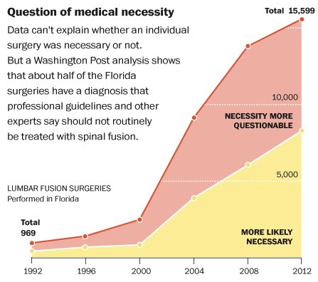
Washington Post 10/27/2013

Slide 20
Colorado Examples
Prenatal Genetic Testing
Transgender Services
Notes:
1) Prenatal genetic testing—Colorado Medicaid pays for 4 different types of genetic tests without conclusive evidence are which are most effective, though the 4 vary significantly in price. This is a specific area where Colorado Medicaid needs more evidence to make informed coverage decision. 2) Transgender Services—good example of how we worked with MED.

Slide 21
4. How do you address a policy or coverage decision for which there is insufficient evidence available?

Slide 22
What if the evidence is not solid or new Rx/technology is rapidly emerging?
Example: Over 90% of new devices are approved by FDA on 510K approval, e.g., substantially equivalent to pre-1976 amendments to FD&C Act
WA AMDG has developed a Dossier program (mini-health technology assessment) to request detailed info from device manufacturer, then make policy coverage determination (Landaas, et al. Int J Tech Assess Health Care 2016;32: 140-46)
Other options: create evidence-based guidelines for UR

Slide 23
Benefits Collaborative Keys To Success
Transparency
We set realistic expectations from the start (e.g. we name the constraints we are operating under)
We are clear about roles (e.g. stakeholders will consult; they will not vote)
We show our work (we create a simple document that catalogues the kind of
feedback received to-date and where our organization is in the process of
researching and deciding upon that feedback. We share it publicly and update it
more than once).
Routine Communication
We provide updates to interested stakeholders at consistent and predictable intervals
(at least once a month), even if the update is “no update”.
Guiding Principles We are clear from the outset that feedback received will only be operationalized if it meets the guiding principles of our process.
Notes:
Script:
Highlight benefits collaborative—created 5 years ago to leverage resources of community, supplemental funding for research. Will talk about program success.
We feel that, in a public, policy design process, it is important to set realistic expectations…[Read Slide]
… We continually evaluate this process for efficiencies and are aided by stakeholders who volunteer process improvement feedback during the process and from who we solicit feedback after the process.
The model works because we are transparent, we communicate regularly (as we work to improve upon a draft policy based on the feedback received), and we set clear guiding principles.

Slide 24
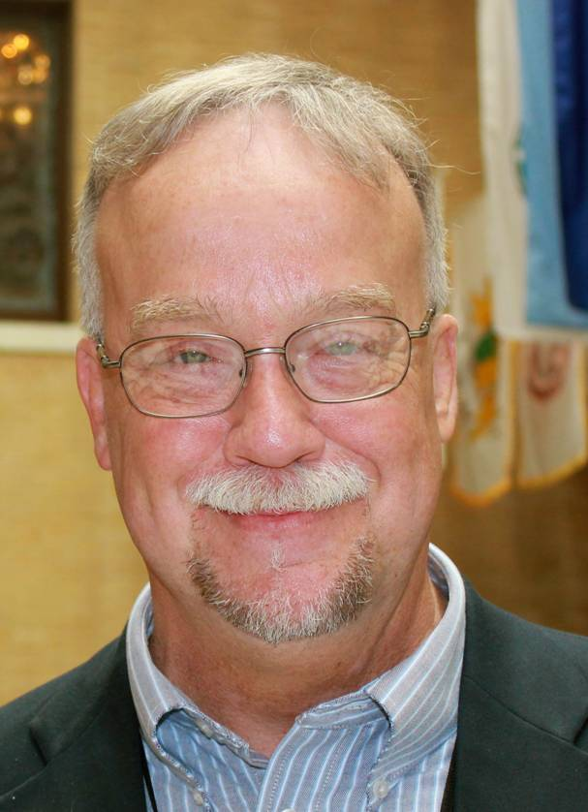

Engaging Consumers in Evidence-Based Policymaking
Rob Walker External Consumer Engagement Liaison, Massachusetts Department of Mental Health | Margaret Guyer Director, Workforce Development, Massachusetts Department of Mental Health

Slide 25
Not All Apples Are The Same
Community Service Agency for Children and Adolescents to age 21
Teens were not taking advantage of the services
Grant to find out why
Created Youth Advisory Groups
Lessons learned:
No meetings at 8 AM
Sushi not pizza
Red apples not green apples
Young adult peer mentors

Slide 26
Consumer Voice
Office of Recovery and Empowerment (Consumer Affairs)
Directors of Recovery in each of the 5 Areas
Transition Age Youth Peer Coordinator
State Mental Health Planning Council

Slide 27
Role of State Agencies Instituting a culture of inclusion
State regulations
Consumer Advisory Boards
Contract Procurement
Mission, values, service principles
Specific structures
Notes:
Lead By Example
Prepare for your agenda to change
Hiring Practices
Work environment
Integrate consumer and family into development, evaluation, and changes

Slide 28
Making it Real
Resources, resources, resources
Engage allies and advocates
Relinquish ‘expert’ role
Listen
Use the input!
Time, time, time
Notes:
Pay people!
Dedicate staff

Slide 29

Audience Questions & Discussion
Please type your questions into the chat box.
29

Slide 30
Impact of Washington Evidence Programs
Rx Drug Program➛Formulary➛Work Comp with 94% generic use rate and ⬇drug $$
AMDG➛Opioid guidelines➛44% decline mortality
Health Technology Assessment Program➛Lumbar fusion for chronic low back pain non-covered
WA Bree Collaborative➛Warrantee bundles for Hip/knee replacement, lumbar fusion

Slide 31
Contact
 | Greg Martin Deputy, Chief Engagement and Dissemination Officer PCORI gmartin@pcori.org
 | Gary Franklin Medical Director, Washington State Department of Labor and Industries; Co-Director, Washington Agency Medical Directors’ Group meddir@u.washington.edu; ljl2@uw.edu
 | Kimberley Smith Compliance & Stakeholder Relations Unit Manager, Colorado Department of Health Care Policy & Financing Kimberley.Smith@state.co.us
 | Rob Walker External Consumer Engagement Liaison, Massachusetts Department of Mental Health Robert.Walker@MassMail.State.MA.US
 | Margaret Guyer Director, Workforce Development, Massachusetts Department of Mental Health margaret.guyer-deason@state.ma.us

Slide 32
Thank you!
Your opinion is important to us. After the webinar ends, you will be redirected to a web page containing a short survey. Your answers to the survey will help us as we plan future NASHP webinars.

Slide 33
Resources

Slide 34
Hierarchy of Evidence
Best: Meta-analysis of large randomized head-to-head trials.
Large, well-designed head-to head randomized controlled clinical trials (RCT):
Long-term studies, real clinical endpoints
Well accepted intermediates
Poorly accepted intermediates
Smaller RCTs, or separate, placebo-controlled trials
Well-designed observational studies, e.g., cohort studies, case-control studies
Safety data without efficacy studies
Case series, anecdotes
Least: Expert opinion, non-evidence-based expert panel reports, and other documents with no direct clinical evidence
Notes:
Describe hierarchy of evidence.

Slide 35
Washington AMDG Guideline Advisory Committee
Clinicians
David Beck – Grays Harbor Clinic
Randi Beck – Group Health Cooperative
Malcolm Butler – Columbia Valley Community Health
Phillip Capp – Swedish Medical Center Family Practice
Greg Carter – St. Lukes Rehabilitation
Dianna Chamblin – Everett Clinic
Pamela Davies – UW/Seattle Cancer Care Alliance Supportive & Palliative Care
Dermot Fitzgibbon – UW/Seattle Cancer Care Alliance
Andrew Friedman – Virginia Mason Medical Center
Debra Gordon – Harborview Anesthesiology & Pain Medicine
Lucinda Grande – Pioneer Family Practice
Chris Howe – Valley Medical Center
Ray Hsiao – Seattle Children's Hospital/UW Department of Psychiatry and Behavioral Sciences
Gordon Irving – Swedish Pain and Headache Center
Joseph Merrill – UW/Harborview Medical Center
Patricia Read-Williams – UW Neighborhood Clinics
Richard Ries – UW/Harborview Medical Center Division of Addictions
Andrew Saxon – VA Puget Sound Health Care System/Center of Excellence in Substance Abuse Treatment and Education (CESATE)/UW Addiction Psychiatry Residency Program
Michael Schatman – Foundation for Ethics in Pain Care
Mark Sullivan – UW Center for Pain Relief/Department of Psychiatry and Behavioral Sciences
David Tauben – UW Center for Pain Relief/Division of Pain Medicine
Greg Terman – UW Department of Anesthesiology
Stephen Thielke – Seattle VAMC Geriatric Research, Education and Clinical Center
Michael Von Korff – Group Health Cooperative
Health Plans
Ken Hopper – Amerigroup, Washington
James Luciano & Thomas Paulson – Wellpoint Companies
Mary Kay O’Neill – Coordinated Care/Bree
State Agencies
Stephen Hammond - DOC
Kathy Lofy – Dept of Health
Gary Franklin, Lee Glass, Nicholas Reul & Hal Stockbridge – Labor and Industries
Dan Lessler & Charissa Fotinos – Medicaid, State employees benefits
Boards and Commissions
Richard Brantner - MQAC

Slide 36
Source: Washington State Department of Health

Slide 37
Distribution of Quality of Care-what about docs who are harming our citizens
Average Medical Costs Average Disability Costs
Questionable Health/ Disability Outcomes
Moderate to High Medical Costs
Moderate to High Disability Costs
Poor Health/ Disability Outcomes
Low or Average Medical Costs Reduced Disability Costs
Excellent Health/ Disability Outcomes
High Medical Costs
High Disability Costs
Very Poor Health/ Disability Outcomes
Community Physicians
Zone 1
Zone 2
Zone 3
Zone 4
Clinical Efficiency
Good
(Costs & Quality)
Poor

